Slide 1
BASIC HTML AND CSS
IECEP-MUSC

Slide 2
WHAT IS HTML
HTML stands for Hyper Text Markup Language
Language for creating web pages
Structure
Building blocks

Slide 3
NEED TO KNOW
HTML is not case sensitive but for formality, we will write HTML in lowercase

Slide 4
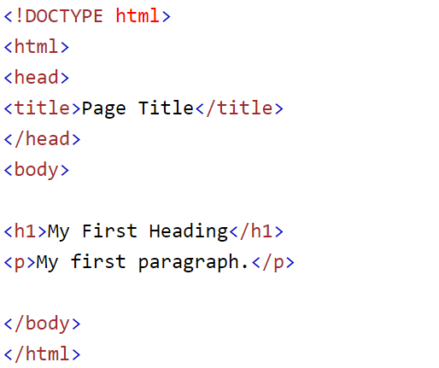
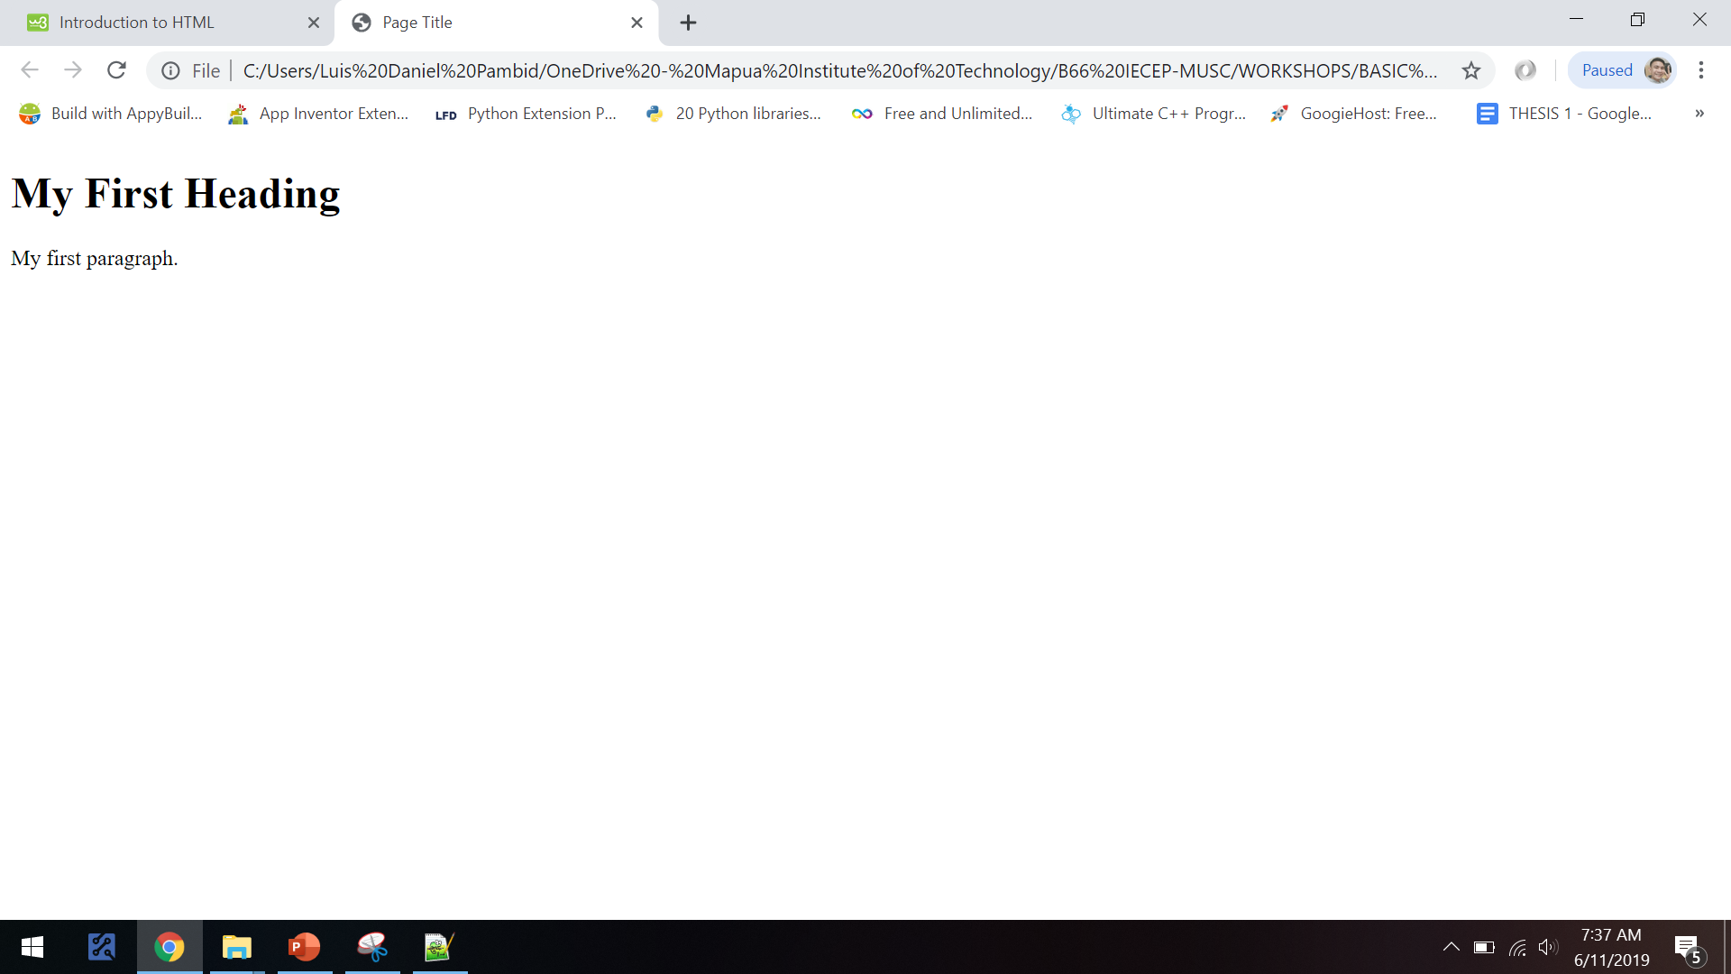
EXAMPLE

Slide 5
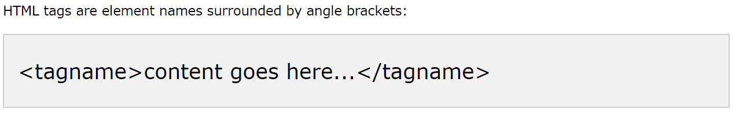
HTML TAGS
Come in pairs like <p> and ends with </p>
<p> - start tag
</p> - end tag (with forward slash)

Slide 6
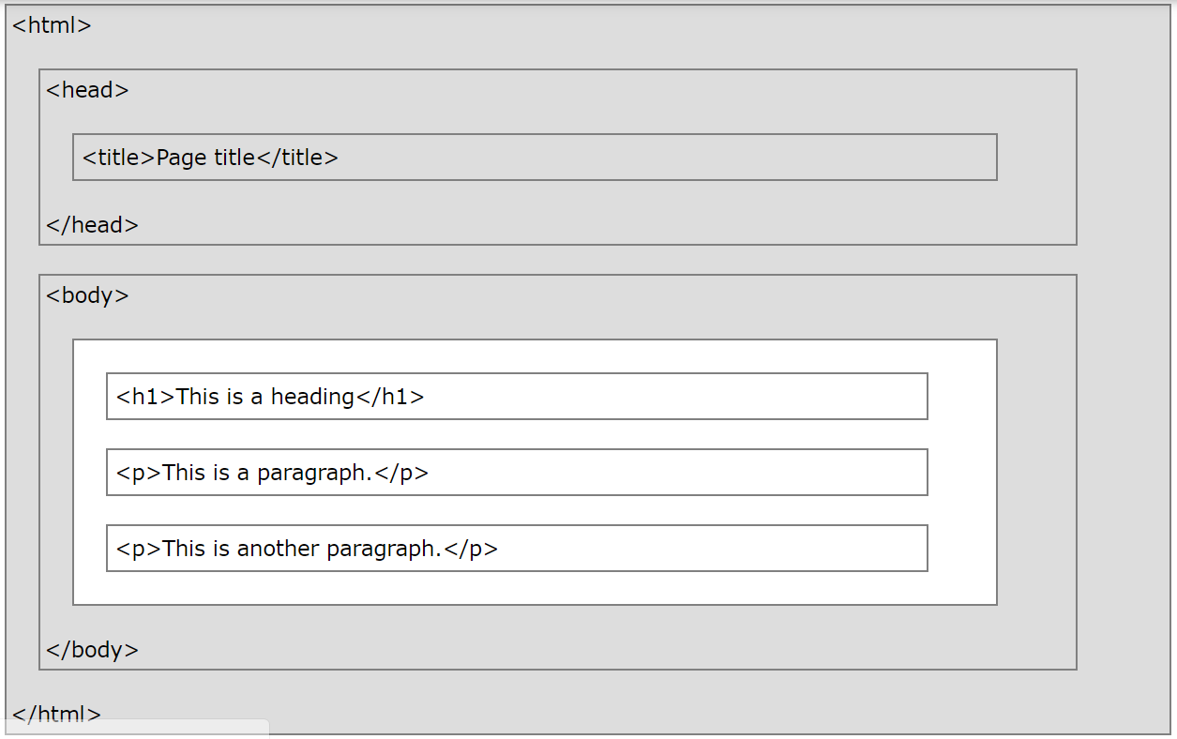
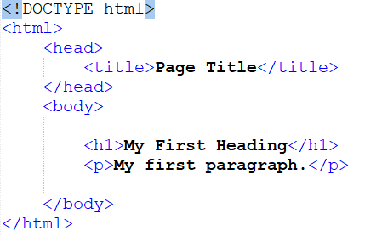
STRUCTURE

Slide 7
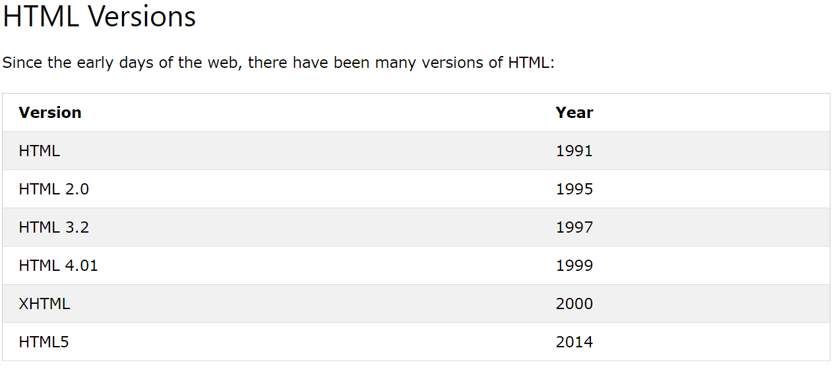
Html versions

Slide 8
Basic html tags

Slide 9
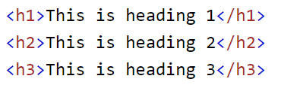
Html headings
<h1> - <h6>
Biggest to Smallest

Slide 10
HTML links
<a>

Slide 11
Html images
<img>
Attributes – additional informations
src – source
alt – alternative text
width & height - attributes

Slide 12

HTML BUTTONS
<button>

Slide 13
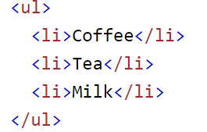
HTML LISTS
<ul> - (unordered/bullet list)
<ol> - (ordered/numbered list)
<li> - list items

Slide 14
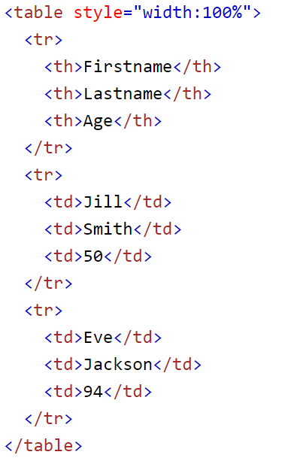
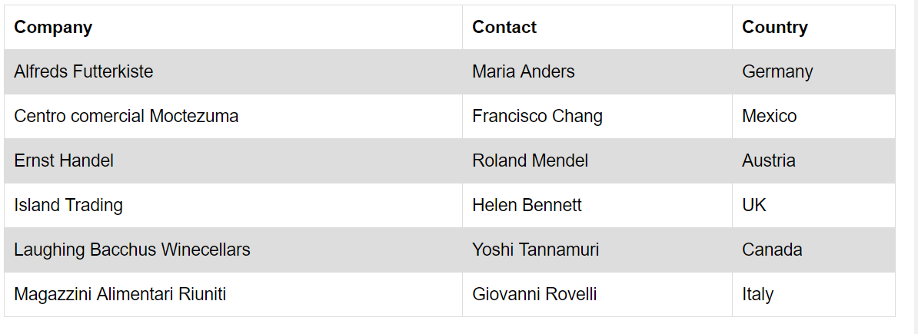
HTML TABLE
<tr> - table row
<th> - table header
<td> - table data

Slide 15
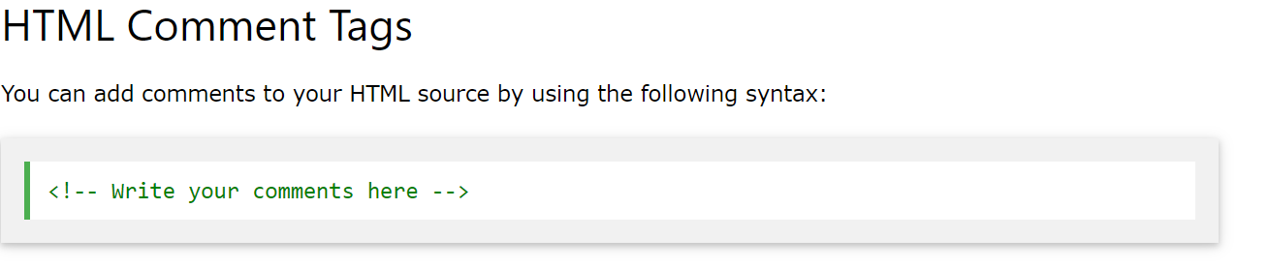
HTML COMMENT

Slide 16
BASIC CSS

Slide 17
What is css
CSS stands for Cascading Style Sheets
CSS describes how HTML elements are to be displayed on screen, paper, or in other media
CSS saves a lot of work. It can control the layout of multiple web pages all at once
External stylesheets are stored in CSS files

Slide 18
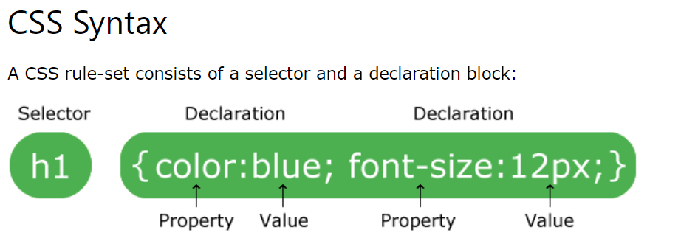
CSS SYNTAX

Slide 19
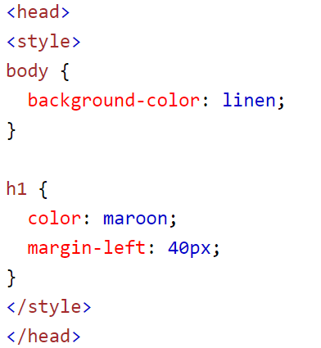
Internal Style Sheet

Slide 20
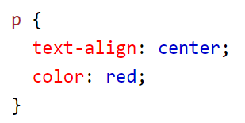
TYPES OF SELECTORS
Element selector

Slide 21
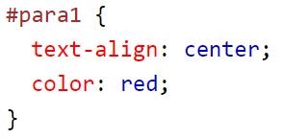
TYPES OF SELECTORS
Id selector

Slide 22
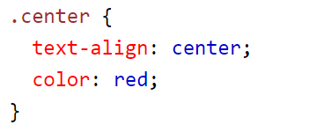
TYPES OF SELECTORS
Class selector

Slide 23
